Slide 1

KONGUNADU COLLEGE OF ENGINEERING & TECHNOLOGY (AUTONOMOUS)
( (Approved by AICTE, Accredited by NBA (CSE,ECE,EEE &MECH) and NAAC & Affiliated by Anna University) NAMAKKAL- TRICHY MAIN ROAD, THOTTIAM,TRICHY DEPARTMENT OF COMPUTER SCIENCE AND ENGINEERING
END SEMESTER UG-PROJECT
VIVA VOCE
PROJECT GUIDE :
Dr. A. RAJAPRABU , AP/CSE
PREPARED BY:
DHANARAJ R (621322104019)
GOWTHAM S (621322104029)
NITHISH S J (621322104061)
BATCH NO: 13

Slide 2
EYE-GAZE CONTROLLED WHEELCHAIR USING MACHINE LEARNING AND DEEP LEARNING APPROACH

Slide 3
ABSTRACT
Individuals with locomotor disabilities or paralysis often struggle with independent mobility due to their inability to operate traditional wheelchairs that require manual or joystick control. This affects their autonomy and quality of life, making them dependent on caregivers for daily movement. To address this challenge, this project proposes an intelligent eye-tracking based smart wheelchair control concept that enables users to navigate and interact using only their eye movements. In the initial phase, a software-based system is developed, where real-time eye movements are captured using a webcam and processed with OpenCV and Python to detect gaze direction and blinks. These outputs are classified and mapped into commands such as forward, backward, left, right, stop and PDF scrolling. As a future enhancement, these commands will be integrated with Raspberry Pi and wireless communication for real wheelchair control. This AI-driven solution aims to provide a hands-free, real-time assistive system that enhances independence and safety for physically disabled individuals.

Slide 4
PROBLEM STATEMENT
Current human–computer interaction methods are not suitable for individuals with limited mobility, as they depend on physical input devices. Existing eye-tracking systems often suffer from low accuracy due to lighting variations, head movement, and occlusions, along with challenges in real-time performance. This work addresses these issues by developing a vision-based system that integrates eye detection, gaze estimation, and blink recognition using optimized machine learning techniques to provide accurate, real-time, and hands-free interaction.

Slide 5
INTRODUCTION
The system is designed to assist individuals with locomotor disabilities or paralysis by enabling a smart wheelchair that can be controlled entirely through eye movements. It uses software-based eye tracking powered by OpenCV and MediaPipe Face Mesh to detect gaze direction and blink patterns in real time. These eye inputs are processed using machine learning–based SVM classification to generate accurate navigation commands, allowing users to control wheelchair movement without hand support. Additionally, accessibility is extended through eye-gaze–based PDF scrolling and digital document interaction, enabling users to read and navigate content with ease. Overall, this AI-driven, hands-free control system enhances independence, safety, and digital accessibility for physically disabled users.

Slide 6
LITERATURE SURVEY
S.No | Authors & Year of Publication | Type of publication | Title of the paper | Algorithm | Advantages & Limitations
1 | Yoshiike Abderrahmane Kheddar Year: 2025 | IEEE Robotics and Automation | Humanoid-Human Sit-to-Stand-to-Sit Assistance | DCM + VRP + Multi-body Dynamics & Feedback Control | Provides real-time assistance based on human balance
 |  |  |  |  | Requires highly accurate sensors
2 | Nealson Li Muya Chang Arijit Raychowdhury Year: 2024 | IEEE Transaction on Pattern Analysis and Machine Intelligence | E-Gaze: Gaze Estimation With Event Camera | Event-based Feature Extraction RNN + LSTM | Work with Ultra-low latency
 |  |  |  |  | Complex event-based data processing
3 | Mohamed Abul Hassan Chad M. Aldridge Yan Zhuang, et al. Year: 2023 | IEEE Transaction on Biomedical Engineering | Approach to Quantify Eye Movements to Augment Stroke Diagnosis With a Non-Calibrated Eye-Tracker | Eye Conjugacy Analysis Spearman’s Rank Correlation | No calibration required
 |  |  |  |  | Limited validation across diverse patient groups

Slide 7
LITERATURE SURVEY
S.No | Authors & Year of Publication | Type of publication | Title of the paper | Algorithm | Advantages & Limitations
4 | Xiaohao Sun Balakumar Balasingam Year: 2021 | IEEE Transaction on Instrumentation and Measurement | Reading Line Classification Using Eye-Trackers | Slip-Kalman Smoother (Slip-KS) Gaussian Discriminant Classifier Support Vector Machine (SVM) | Robust compared to traditional methods
 |  |  |  |  | Affected by noise in eye-tracking data
5 | Yiu-ming Cheung Qinmu Peng Year: 2015 | IEEE Transaction on Human-Machine System | Eye Gaze Tracking With a Web Camera in a Desktop Environment | Adaptive Weighted POSIT (AWPOSIT) Active Shape Model (for face & eye detection) Eye Feature Detection | Works under different Sensors
 |  |  |  |  | Sensitive to extreme head movements

Slide 8
EXISTING SYSTEMS
Existing System | Limitation | Overcome
Eye-Gaze Based Smart Wheelchair Systems | Need hardware support, performance unstable in lighting, no emergency blink safety | Fully software-based, stable real-time AI gaze tracking, blink emergency stop
Deep Learning-Based Eye Blink Detection in Video Frames | Sensitive to lighting and background variations | More stable in varying lighting conditions and Adds blink emergency stop for safety

Slide 9
DISADVANTAGES
Lighting sensitivity - Performance suffers in darkness, shadows or when lighting conditions change abruptly, with implications for accurate eye detection and tracking.
Head movement limitations - When the user moves their head, consistent tracking is difficult to maintain leading to incorrect gaze estimation.
Threshold dependency - Blink detection methods such as EAR require exact threshold tuning and may differ between users and settings.
Occlusion challenges - We have difficulty in identifying the eye when it is partially blocked by glasses, hair, or reflections.

Slide 10
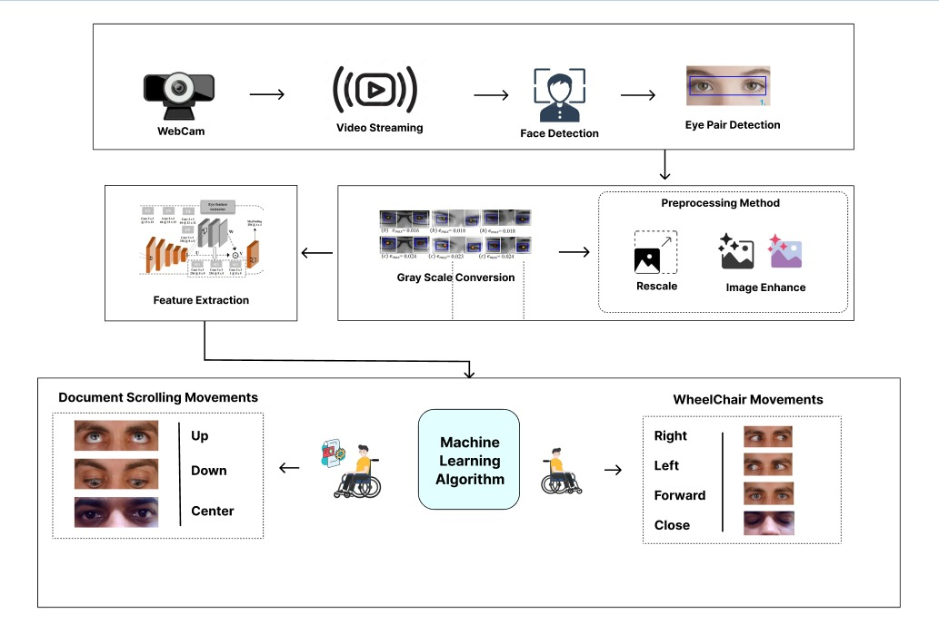
ARCHITECTURE DIAGRAM

Slide 11
PROPOSED SYSTEM
The system uses eye-tracking software to control the wheelchair using eye movements.
Python and OpenCV detect gaze direction and blinks in real time.
Eye gaze is used to move the wheelchair forward, left, right, or stop.
Users can scroll and read PDF documents using only their eye movements.
The system aims to improve user independence and reduce the need for caregiver support.

Slide 12
ADVANTAGES
Hands-free control for mobility and documents
Low-cost, software-based system
Safe and reliable with blink emergency feature
Integrated and easy to use

Slide 13
REQUIREMENTS
HARDWARE
Devices - Computer/Laptop (windows 11)
Processor - Intel i3 or above
RAM - Minimum 4GB
Camera - HD Webcam
SOFTWARE
Language - Python
Model - MediaPipe / Haar CasCade
Libraries - OpenCV , NumPy , Tensorflow , Keras
IDE - Visual Studio Code

Slide 14
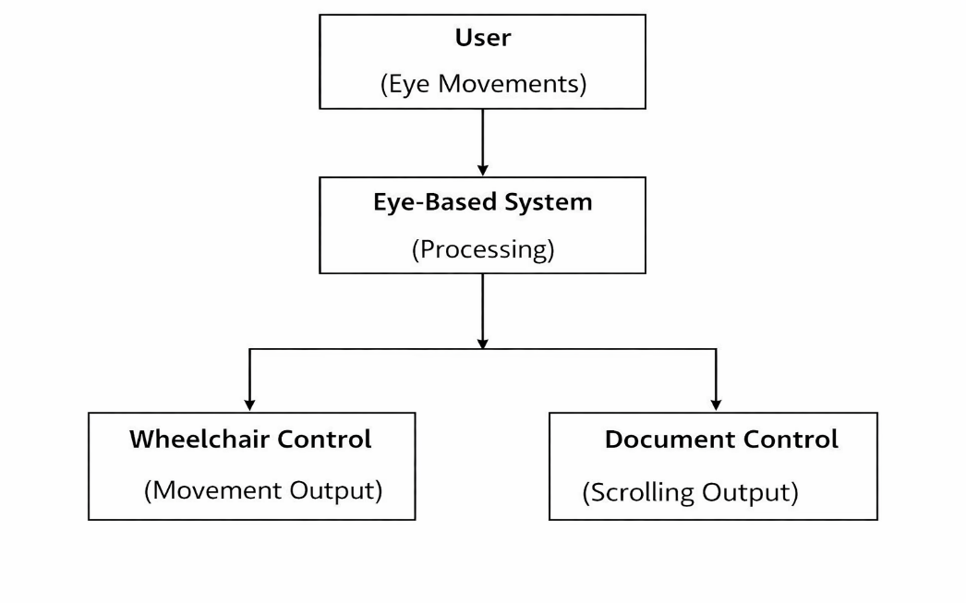
DATA FLOW DIAGRAM : LEVEL 0

Slide 15
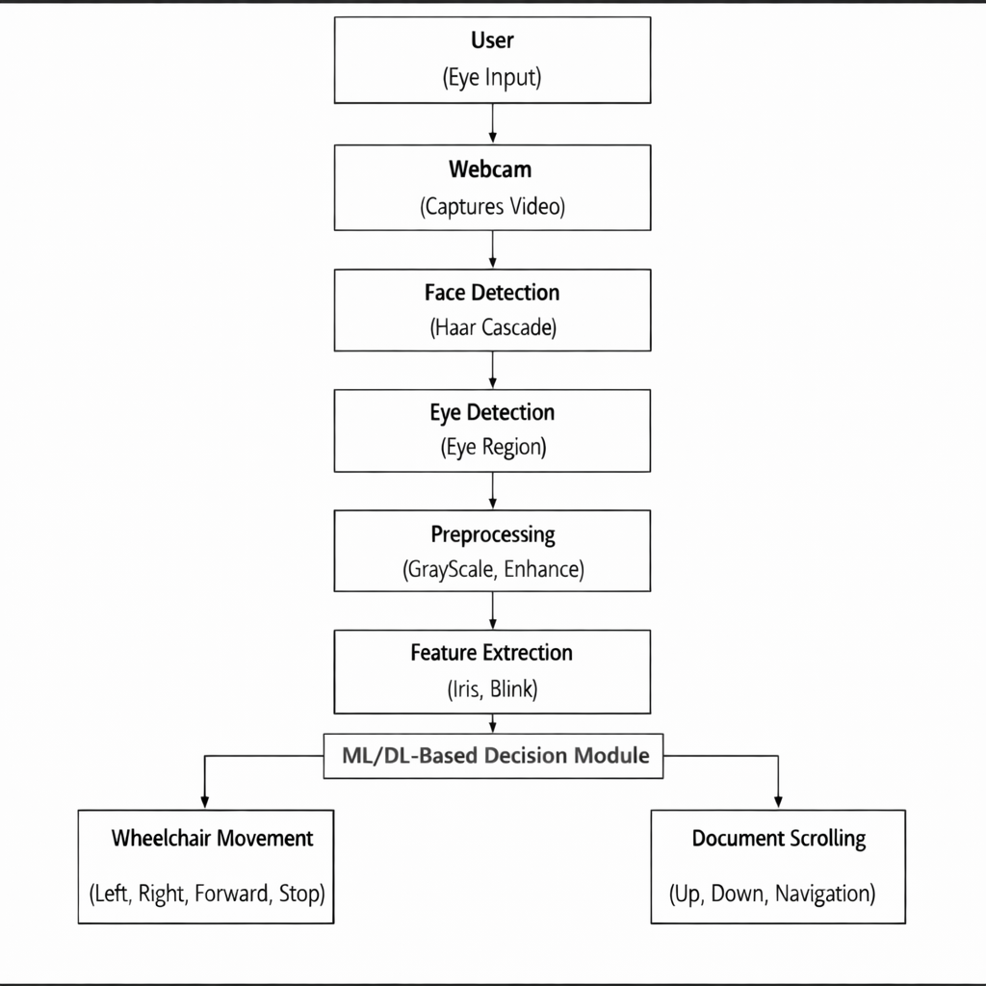
DATA FLOW DIAGRAM : LEVEL 1

Slide 16
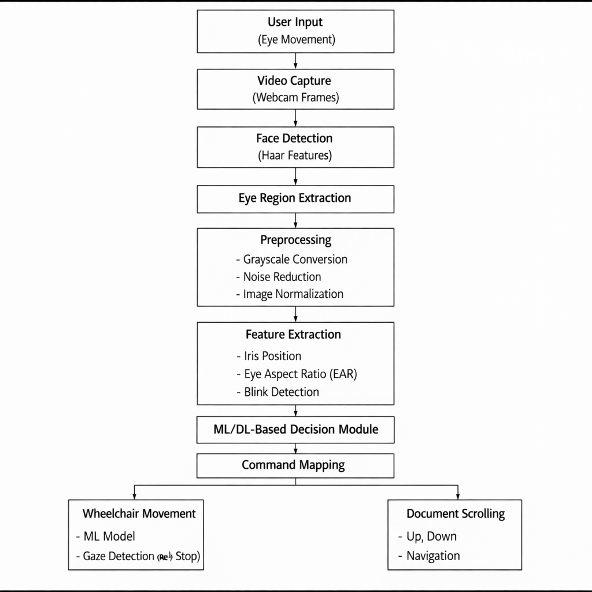
DATA FLOW DIAGRAM : LEVEL 2

Slide 17
MODULE SPLIT-UP
Level 1 - Face Detection
OpenCV captures live video and detects the face using Haar Cascade / MediaPipe, selecting the eye region for further processing.
Level 2 - Eye Region Detection
Left and right eye regions are accurately localized using OpenCV with HOG (Histogram of Oriented Gradients) features along with MediaPipe eye landmarks, ensuring precise and reliable eye tracking.

Slide 18
MODULE SPLIT-UP
Level 3 - Iris Region Extraction
MediaPipe Iris Tracking extracts both the iris center and pupil boundary points to accurately identify pupil movement and gaze direction.
Level 4 - Preprocessing
Frames are converted to grayscale, filtered for noise, normalized for lighting, and resized to improve accuracy and stability.

Slide 19
MODULE SPLIT-UP
Level 5 - Feature Extraction
Important features such as iris position, eyelid opening and blink points are extracted using MediaPipe landmarks and feature techniques.
Level 6 - ML / DL Classification
CNN processes extracted features to classify and predict gaze direction (Left, Right, Forward) and detect blinks in real time, ensuring accurate and safe control.

Slide 20
MODULE SPLIT-UP
Level 7 - Decision Mapping & Command Generation
Classified gaze and blink outputs are converted into wheelchair navigation and PDF control commands.

Slide 21
ALGORITHM USED
Haar Cascade Algorithm – Used for real-time face detection from webcam input.
MediaPipe Face Mesh Algorithm – Used to detect facial landmarks and locate eye regions accurately.
MediaPipe Iris Tracking Algorithm – Used to track iris position and determine eye gaze direction.
Blink Detection Algorithm – Used to detect eye blinks for command selection and emergency stop.
CNN Classification Algorithm – Used to classify gaze direction and blink patterns.
Eye-Gaze Based PDF Scrolling Algorithm – Used to scroll and navigate PDF documents using eye movements.

Slide 22
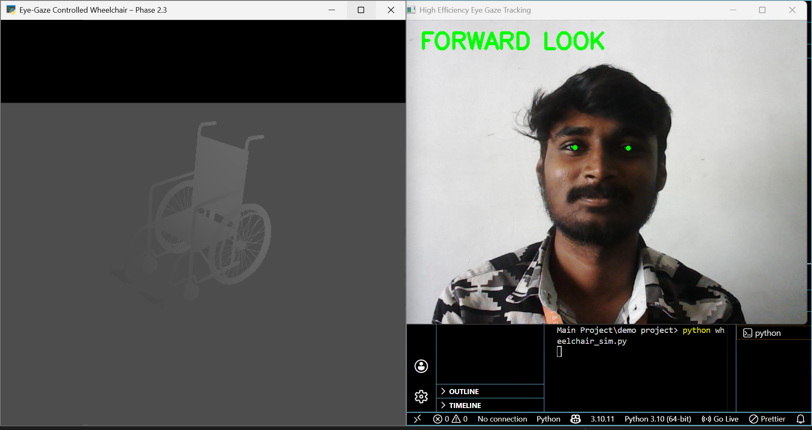
EXPERIMENTAL RESULT
Forward Gaze Wheelchair Movement
The system detects forward gaze as “FORWARD LOOK” and moves the wheelchair straight, ensuring accurate real-time control.

Slide 23
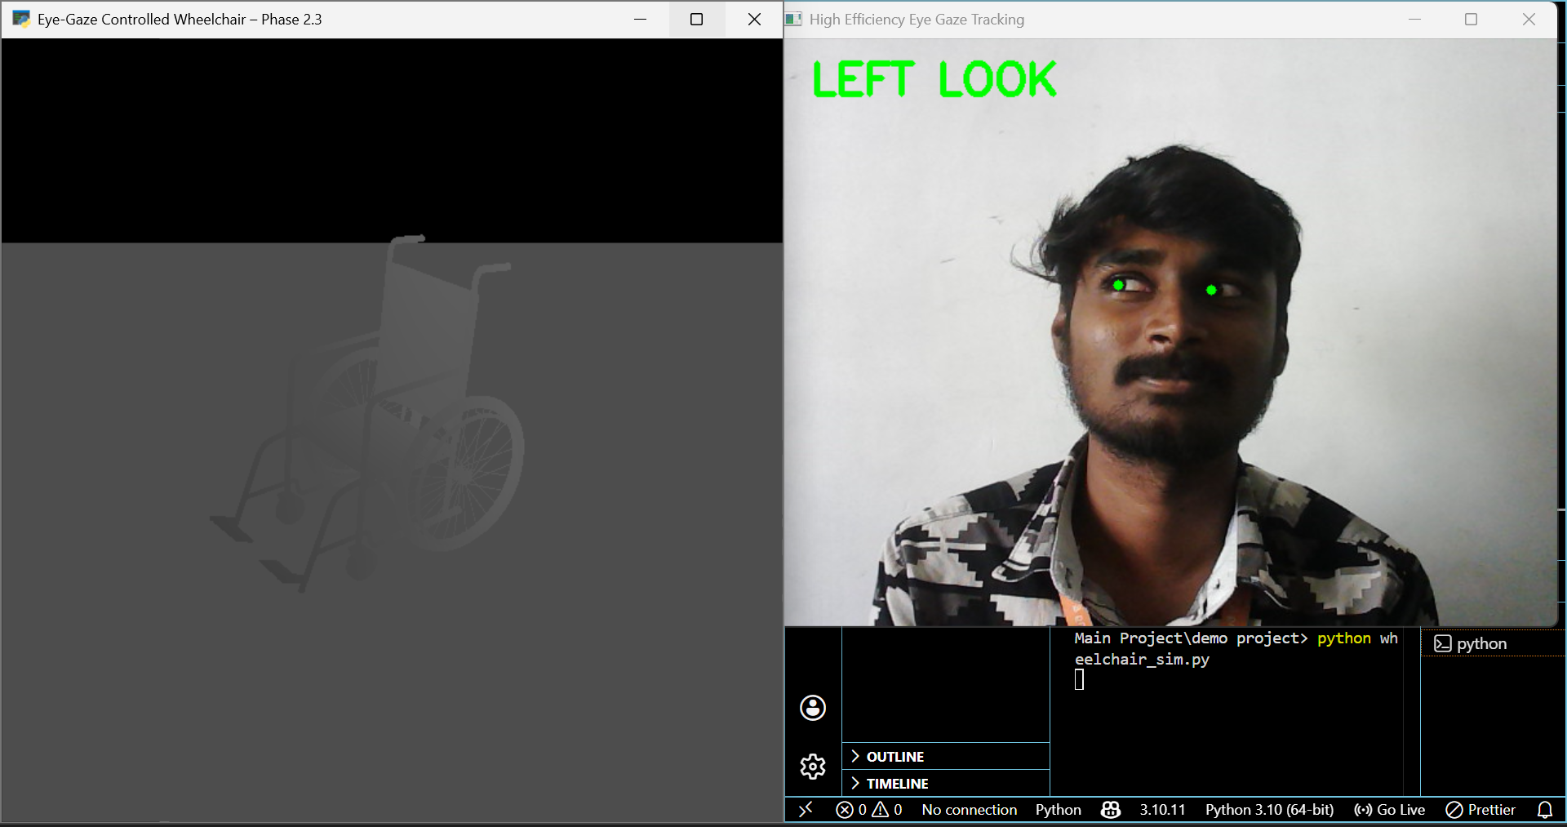
EXPERIMENTAL RESULT
Left Gaze Wheelchair Control
The system detects left gaze as “LEFT LOOK” and turns the wheelchair left, confirming precise real-time movement control.

Slide 24

EXPERIMENTAL RESULT
Right Gaze Wheelchair Control
The system detects right gaze as “RIGHT LOOK” and turns the wheelchair right, enabling effective real-time control.

Slide 25
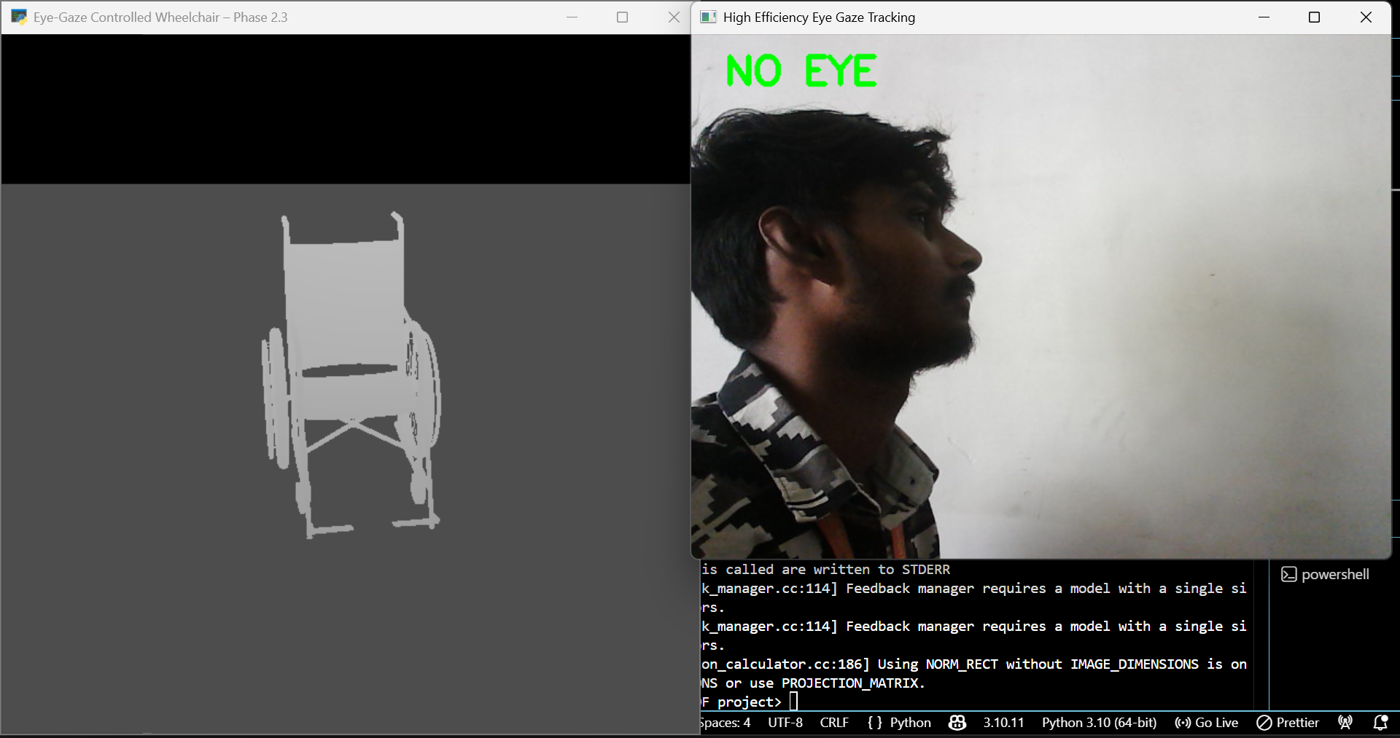
EXPERIMENTAL RESULT
No-Eye Direction Wheelchair Movement
When no eyes are detected (“NO EYE”), the system automatically stops the wheelchair to ensure safety and prevent unintended movement.

Slide 26
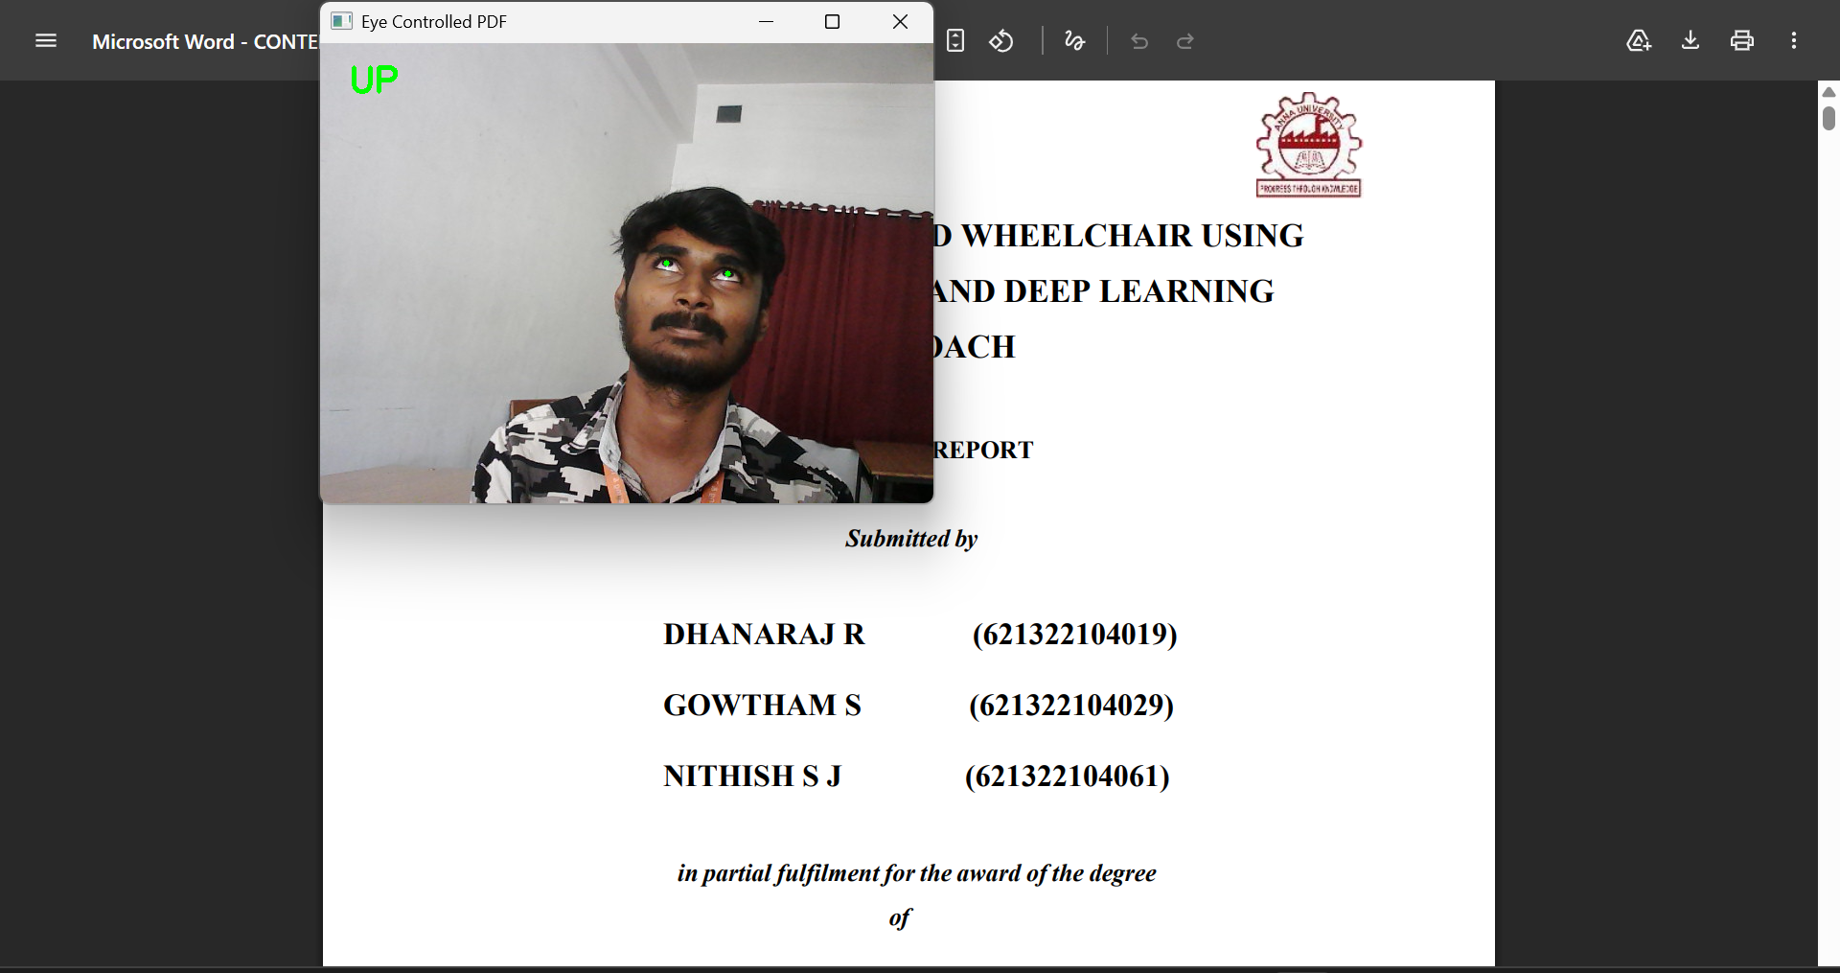
EXPERIMENTAL RESULT
Upward Gaze Document Scroll
The system detects upward gaze as “UP LOOK” and scrolls the PDF upward, enabling hands-free document navigation.

Slide 27
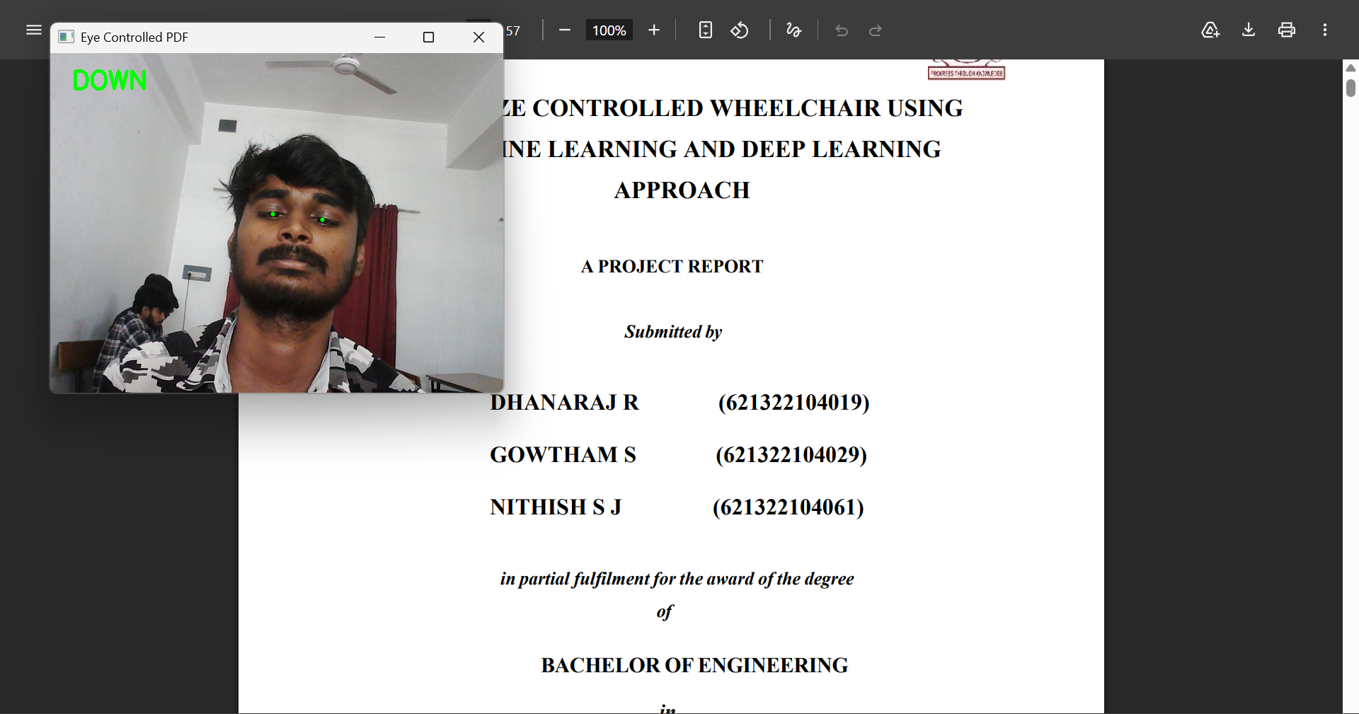
EXPERIMENTAL RESULT
Downward Gaze Document Scroll
The system detects downward gaze as “DOWN LOOK” and scrolls the PDF downward, ensuring smooth hands-free navigation.

Slide 28
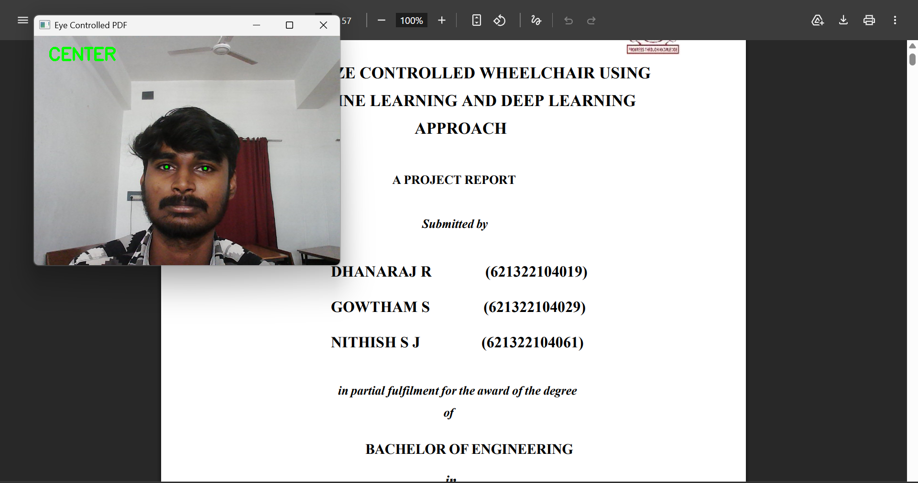
EXPERIMENTAL RESULT
Center Gaze Document Pause
The system detects center gaze as “CENTER LOOK” and stops PDF scrolling, allowing the user to read the document clearly without movement.

Slide 29
CONCLUSION
The system integrates computer vision and machine learning to enable accurate, real-time eye-based interaction. Face detection, eye tracking, iris detection, blink detection, and CNN-based classification are successfully implemented, allowing reliable detection of eye movements and command generation. The system effectively controls the 3D wheelchair model, demonstrating smooth and responsive performance with minimal latency. Core modules, including document scrolling, are completed and functioning efficiently. The system supports gaze-based navigation and interaction. Overall, it provides a scalable, low-cost, and hands-free solution, enhancing accessibility and user independence in real-time applications.

Slide 30
FUTURE ENHANCEMENT
Future enhancements focus on converting the system into a hardware-based model using Raspberry Pi. By integrating a camera module and Python libraries like OpenCV, MediaPipe, and TensorFlow, real-time embedded processing can be achieved. Optimization techniques will reduce computational load and improve efficiency on low-power devices. Wireless modules can enable real-world control and monitoring. Improving model efficiency and reducing latency will further enhance performance. This integration will make the system portable, cost-effective, and suitable for real-time applications, improving usability and accessibility.

Slide 31
REFERENCES
[1] H. Lefèvre, T. Chaki, T. Kawakami, A. Tanguy, T. Yoshiike, and A. Kheddar, ‘‘Humanoid-human sit-to-stand-to-sit assistance,’’ IEEE Robotics and Automation Letters, vol. 10, pp. 210–218, 2025.
[2] C. Wang, R. Wang, Y. Leng, K. Iramina, Y. Yang, and S. Ge, ‘‘An eye movement classification method based on cascade forest,’’ IEEE Journal of Biomedical and Health Informatics, vol. 28, no. 12, pp. 7184–7193, Dec. 2024.
[3] S. Artiran, P. S. Bedmutha, and P. Cosman, ‘‘Analysis of gaze, head orientation, and joint attention in autism with triadic VR interviews,’’ IEEE Trans. Neural Syst. Rehabil. Eng., vol. 32, pp. 759–769, 2024.
[4] N. Li, M. Chang, and A. Raychowdhury, ‘‘E-Gaze: Gaze estimation with event camera,’’ IEEE Transactions on Circuits and Systems for Video Technology, vol. 34, pp. 1450–1460, 2024.

Slide 32
REFERENCES
[5] M. Abul Hassan, C. M. Aldridge, Y. Zhuang, et al., ‘‘Approach to quantify eye movements to augment stroke diagnosis with a non-calibrated eye-tracker,’’ IEEE Journal of Biomedical and Health Informatics, vol. 27, pp. 345–353, 2023.
[6] Xinming Wang, J. Zhang, H. Zhang, S. Zhao, and H. Liu, “Vision-Based Gaze Estimation: A Review,” IEEE Transactions on Cognitive and Developmental Systems, vol. 14, no. 2, pp. 316–326, June 2022.
[7] X. Sun and B. Balasingam, ‘‘Reading line classification using eye-trackers,’’ IEEE Access, vol. 9, pp. 56780–56790, 2021.
[8] Y. Cheung and Q. Peng, ‘‘Eye gaze tracking with a web camera in a desktop environment,’’ International Journal of Computer Vision Applications, vol. 10, pp. 112–120, 2015.

Slide 33
PUBLICATION
Dr. A. RAJAPRABU DHANARAJ R (621322104019), GOWTHAM S (621322104029) AND NITHISH S J (621322104061) has published a paper entitled “EYE-GAZE CONTROLLED WHEELCHAIR USING MACHINE LEARNING AND DEEP LEARNING APPROACH” in Proceedings of an International Conference, pp. 554–563, 2025.

Slide 34
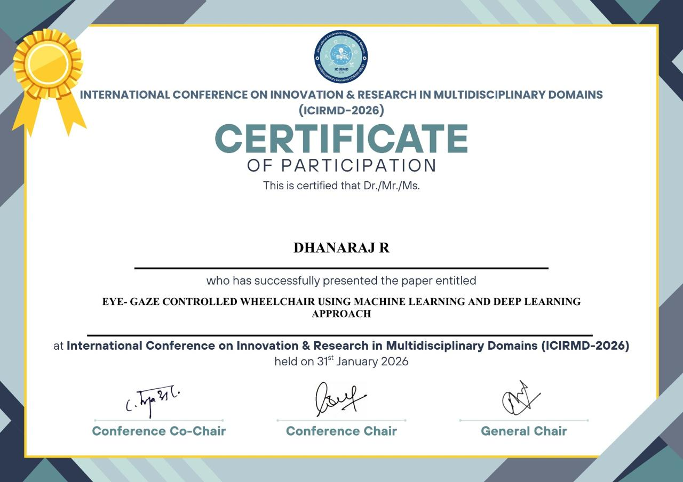

Slide 35
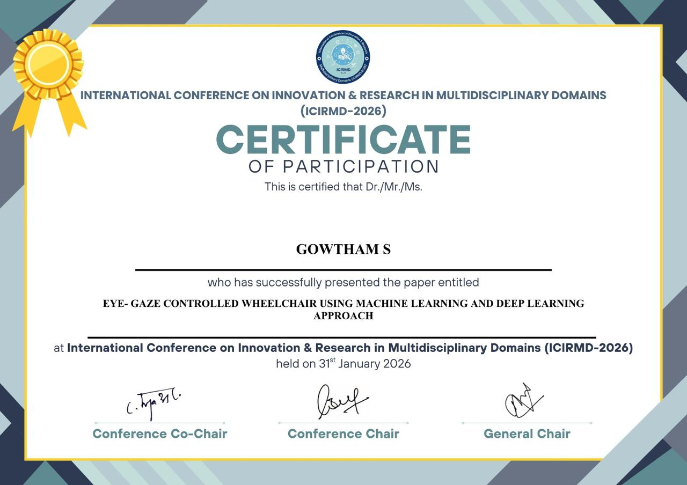

Slide 36


